Slide 1
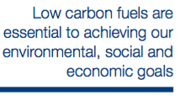
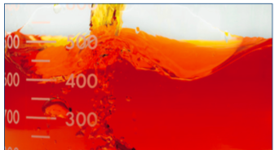
Driving Demand for Low Carbon Fuels
The Bioeconomy “Policy-to-Action” Ecosystem is expanding and evolving.
A concerted effort is needed to accelerate scale up of advanced renewable fuels.
The private sector is increasingly driving uptake of low carbon products.

Slide 2
Biofuels Ecosystem from 2008 to 2015
Demand was entirely policy driven.
Producers and trade groups were the primary policy advocates.
The international Renewable Energy policy environment was typically hostile to biofuels.
International Technical Agencies expertise was NOT connected to national policymaking.
Trade Groups
National Government
Enforced Biofuel Mandate
Biofuel Demand
NGOs & Oil Companies
Public Support

Slide 3
Post-Paris the renewable fuels policy-advocacy ecosystem has expanded:

Slide 4
What more can we do to increase LCF demand?
Trade Groups
National Government
Enforced Biofuel Mandate
Biofuel Demand
Oil Companies & NGOs
Public Support
?

Slide 5
Harnessing Private Sector sustainability leadership to increase demand for Low Carbon Fuels
Trade Groups
National Government
Enforced Biofuel Mandate
Biofuel Demand
Oil Companies & NGOs
Public Support
Corporate Demand

Slide 6
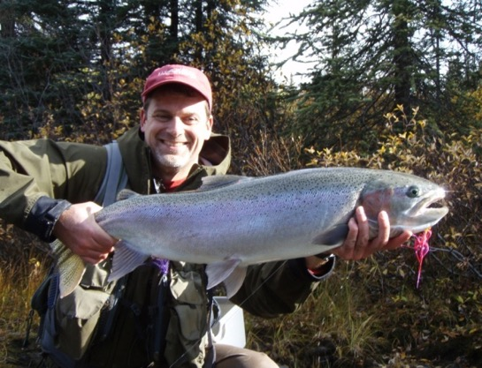
Sponsored by
Gerard J. Ostheimer, Ph.D. ostheimer@wbcsd.org

